Slide 1
ENOCH project branch University Hospital Olomouc 2019 – 2023
- Molecular, cellular and clinical approach to the healthy aging -
CZ.02.1.01/0.0/0.0/16_019/0000868

Slide 2
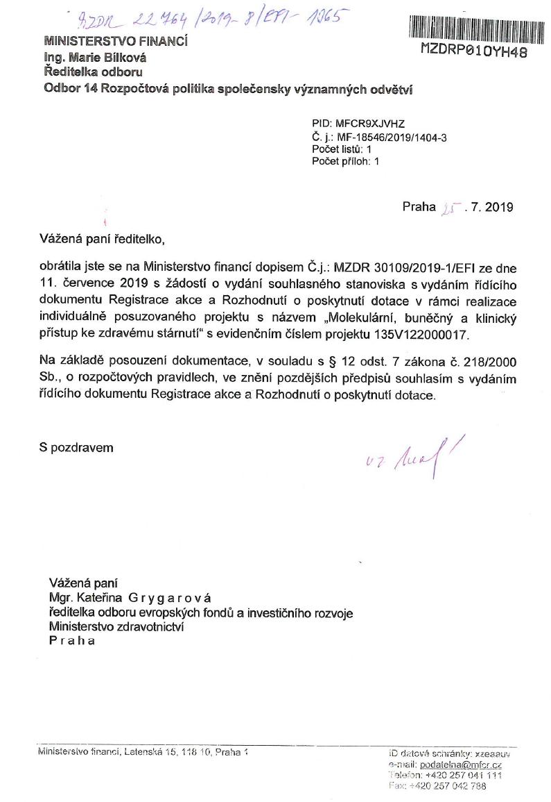

Slide 3
ENOCH project staff at the Department of Neurology, University Hospital Olomouc
Principal investigators – Excellent researchers:
Prof. Ing. Miroslav Strnad, CSc., DSc. (H-i 57)
Prof. MUDr. David Stejskal, Ph.D., MBA, EurChem (H-i 20)
Senior researchers
Mgr. Eva Hényková, Ph.D.
MUDr. Michaela Kaiserová, Ph.D.
Mgr. Vladimíra Koudeláková, Ph.D.
Mgr. Lucie Rárová, Ph.D.
Mgr. Kateřina Sklenářová, Ph.D.
PhDr. Tereza Štecková, Ph.D.
Junior researchers:
MUDr. Tereza Bartoníková
Mgr. Kateřina Bučilová
Mgr. Gabriel Gonzales
MUDr. Monika Chudáčková
Mgr. Lucie Kotková
MUDr. Sandra Kurčová
Mgr. Hanuš Slavík
Mgr. Kateřina Stolaríková
Mgr. Jana Stránská
Project management:
Prof. MUDr. Petr Kaňovský, CSc., FEAN
Prim. MUDr. Pavel Otruba, MBA
Mgr. Petra Řeháková
Ing. Věra Doleželová

Slide 4
ENOCH FNOL research topics:
1. Neurodegenerative research programme
2. Biomarkers of neurodegeneration
3. Clinico-genetical correlation
4. Clinico-pathological correlations in neurodegeneration (brain bank)
5. Peripheral manifestations of neurodegenerative process

Slide 5
Neurodegenerative biomarkers research (core research topic)
Systematic collection of the biological data from all patients referred to the tertiary neurodegenerative centre for assessment. The collection includes the detailed examination of cerebrospinal fluid and subsequent assessment of presence and levels of:
α-synuclein
tau-proteins (separated isoforms)
phosphorylated tau
β-amyloide
amyloid precursor protein (APP)
cystatin C
chromogranin A
neurofilament heavy and light chains (NFH, NFL)
and many others

Slide 6
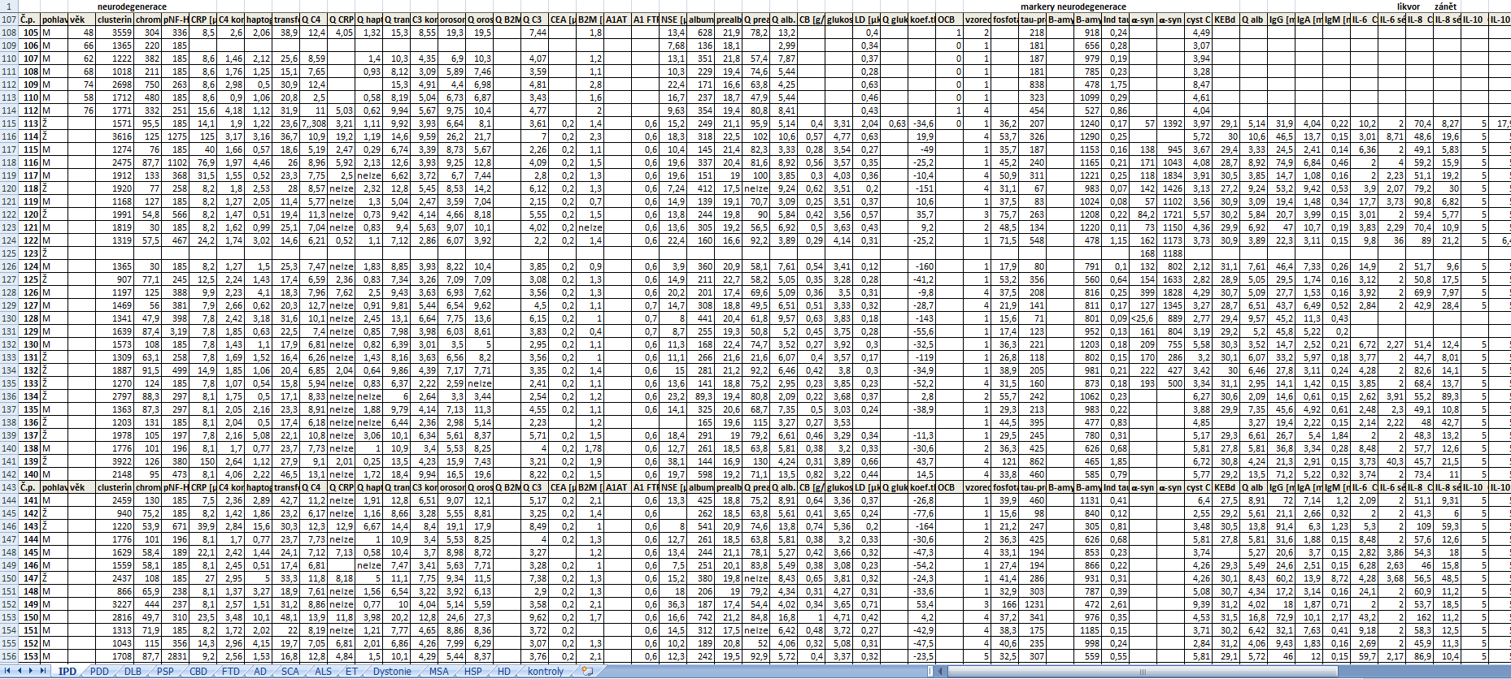
An example of existing database:

Slide 7
2019:
Development of further research projects, which are based on the presented background:
Biomarkers in the very early stage of neurodegeneration
Peripheral manifestations of neurodegenerative proteinopathies
Clinico-biological and pathological correlations in neurodegeneration
Phenotyping and genotyping in neurodegenerative proteinopathies

Slide 8
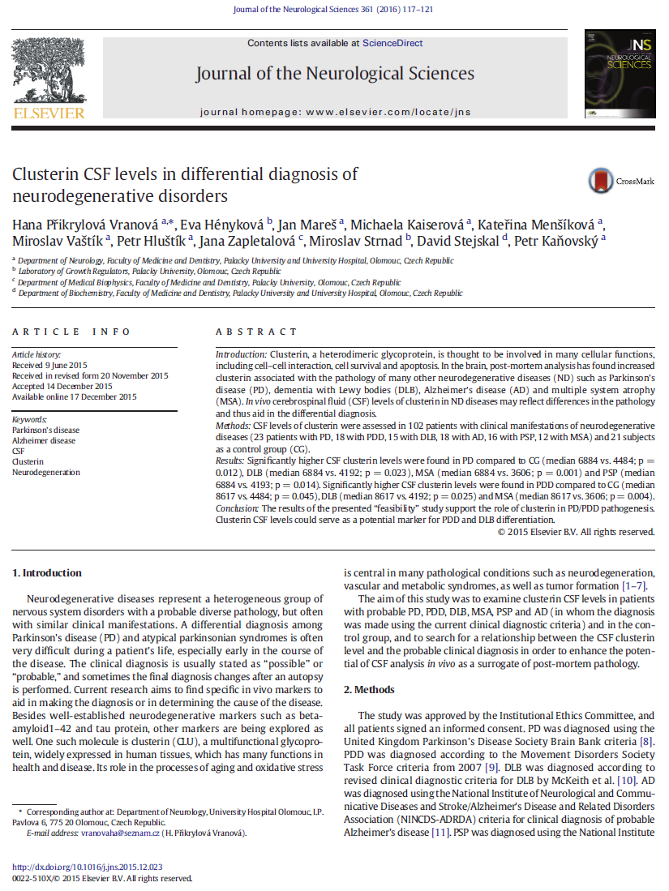
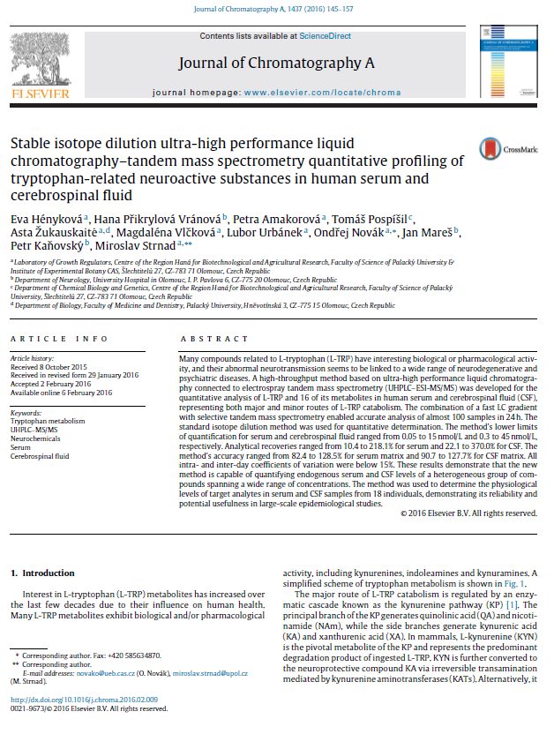
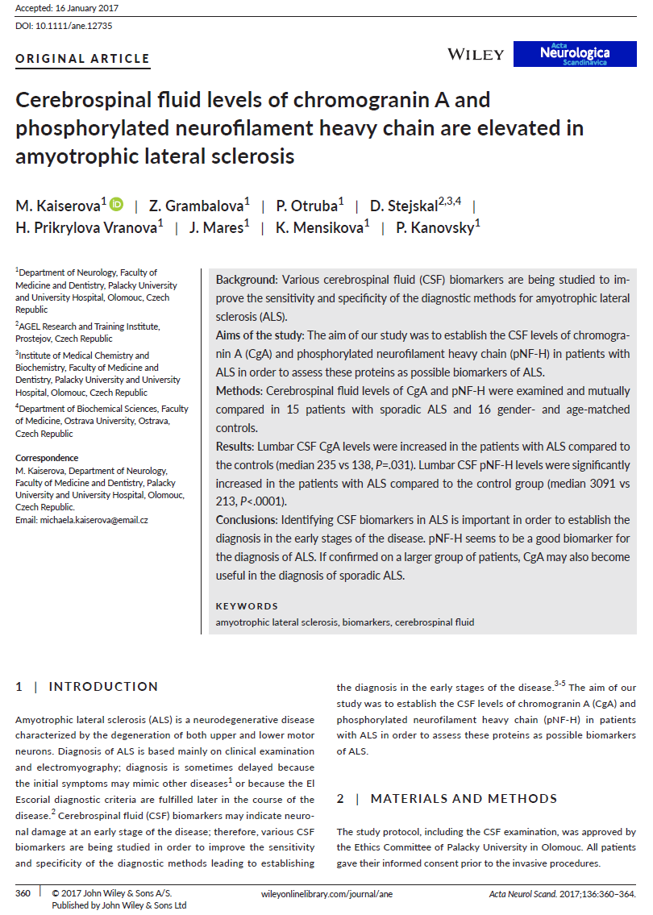
ENOCH FNOL branch background projects, cited in the application

Slide 9
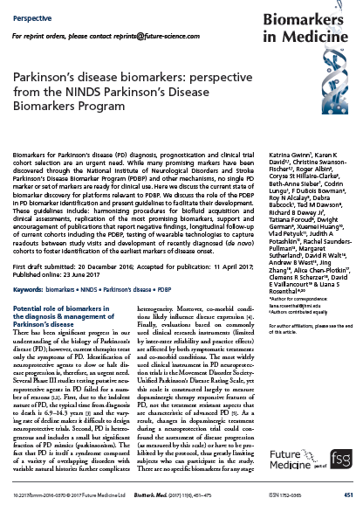
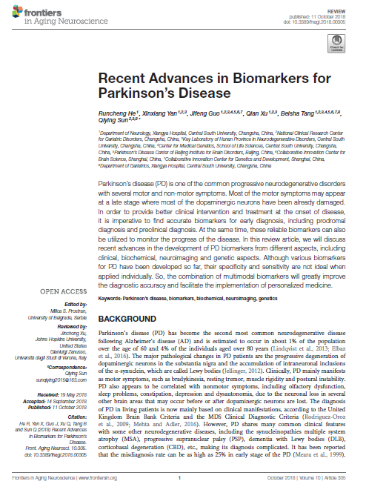
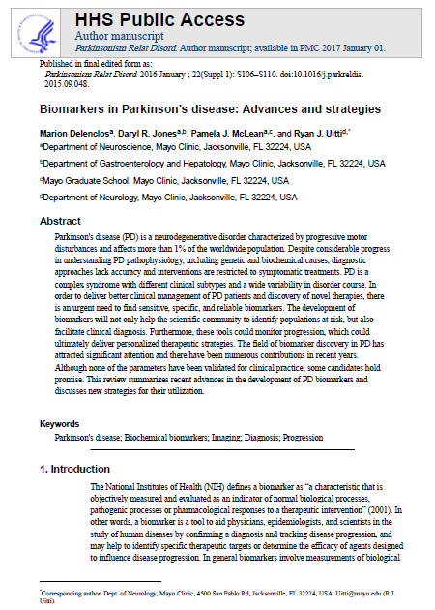
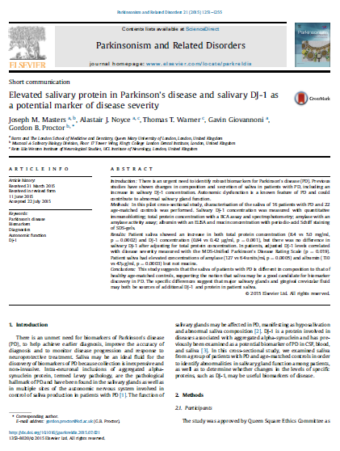
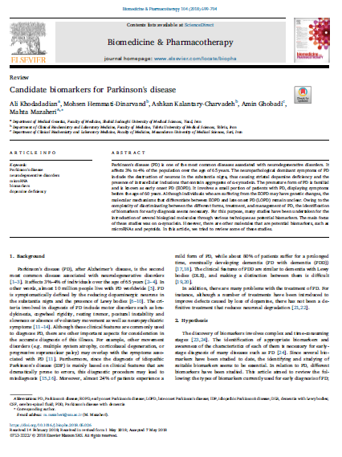
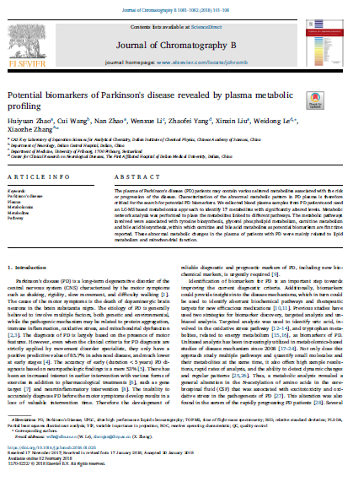

Slide 10
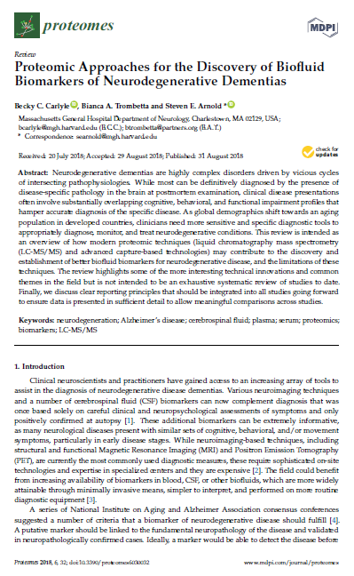
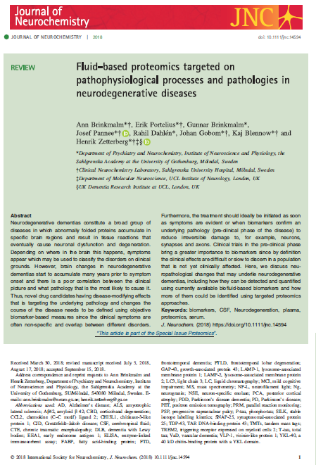

Slide 11
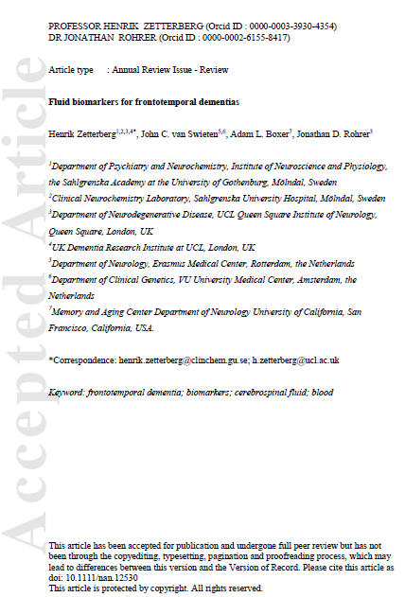
Sdílená metodika s týmem prof. Toma Warnera a prof. Henrika Zetterberga

Slide 12
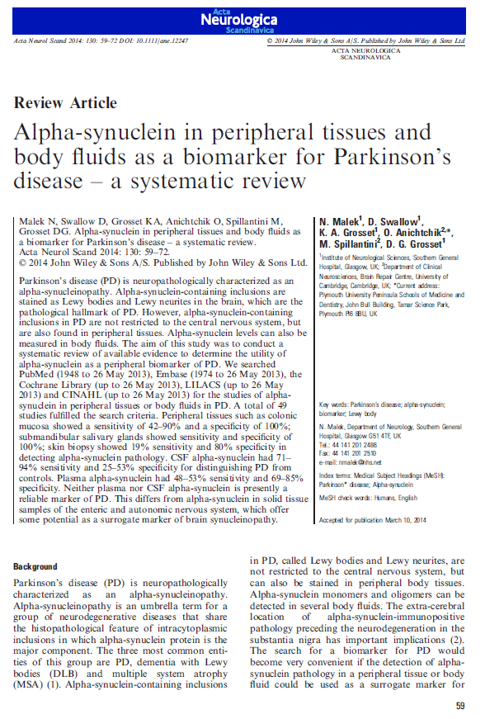
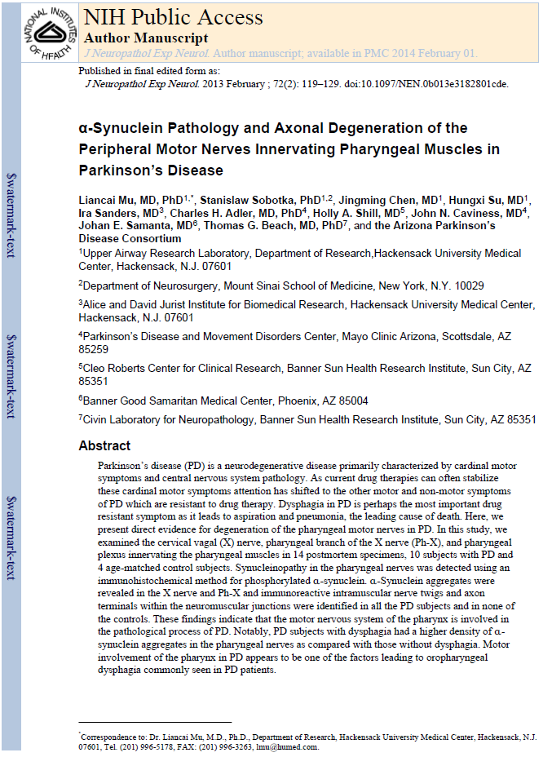
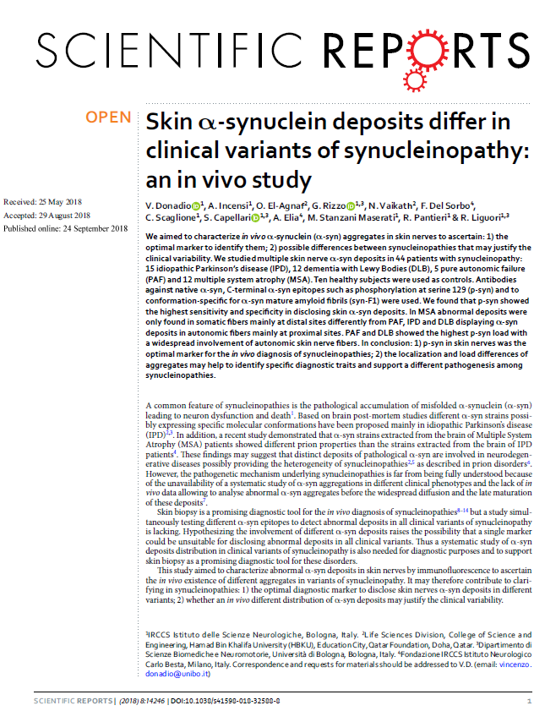

Slide 13
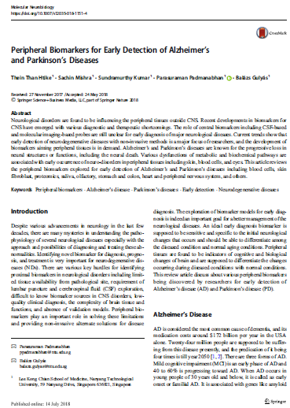
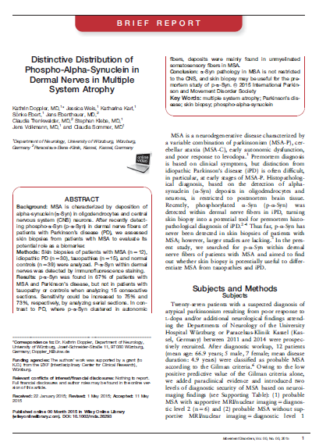
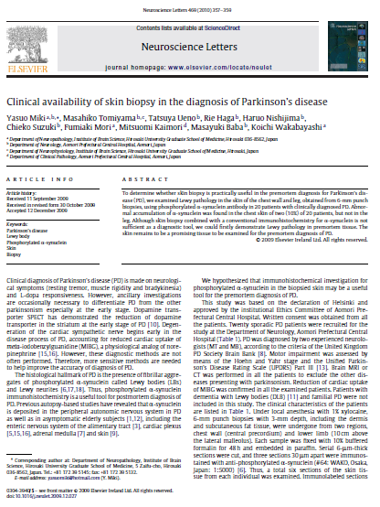
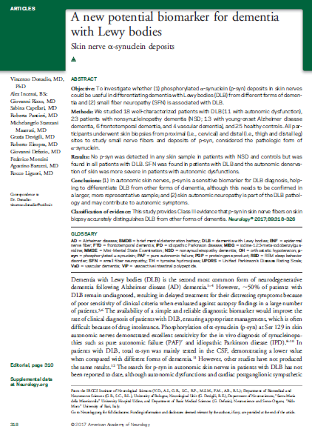
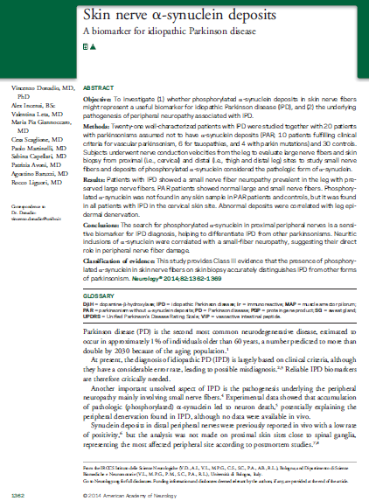
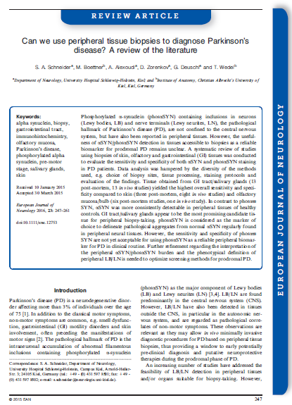
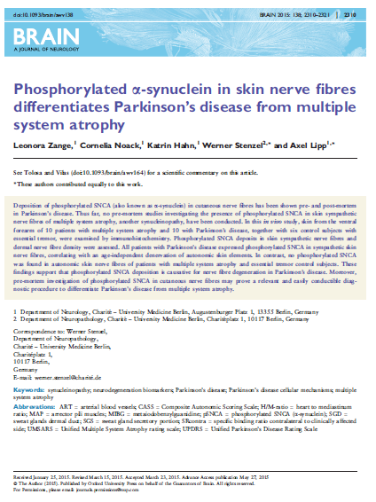
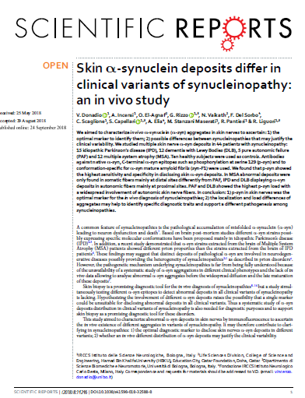

Slide 14
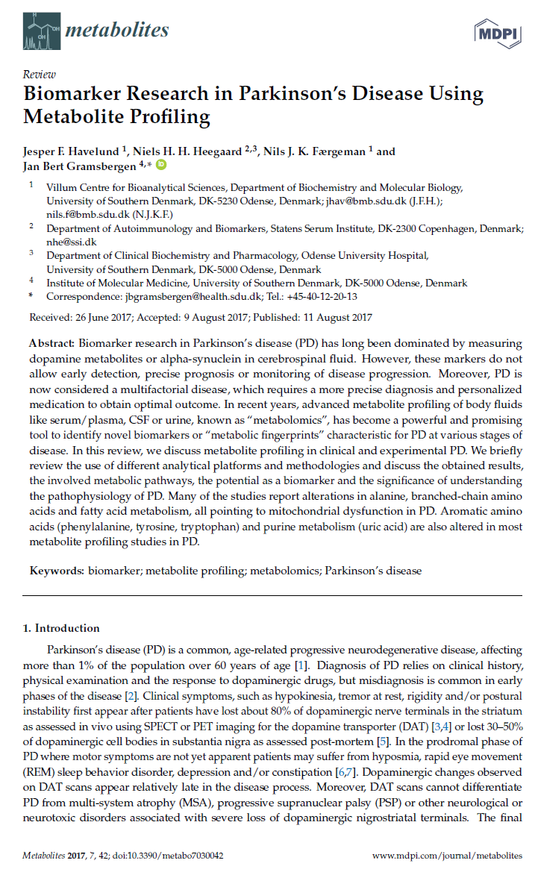
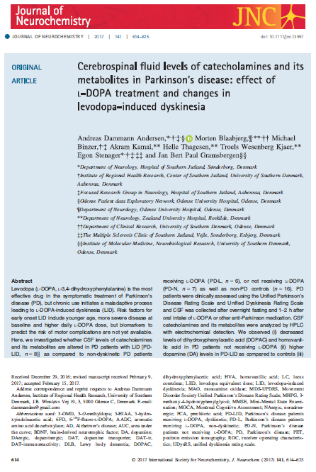

Slide 15
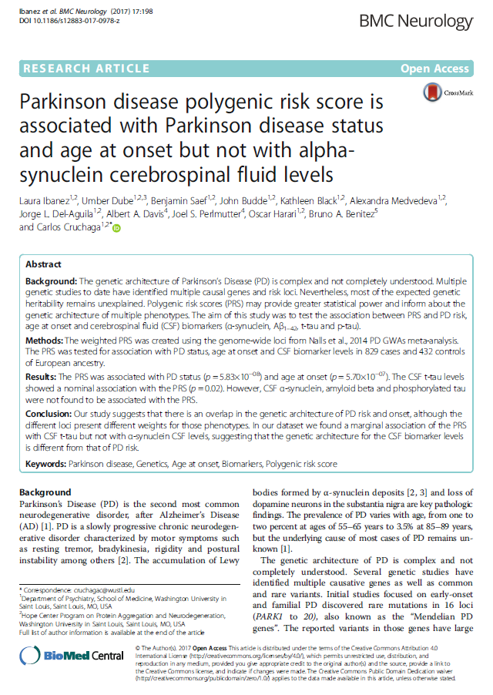

Slide 16
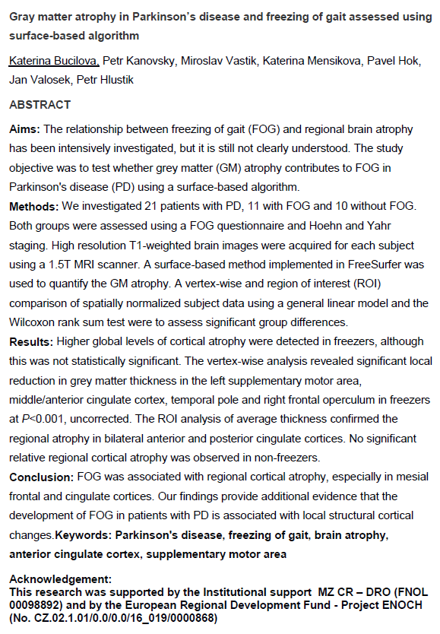
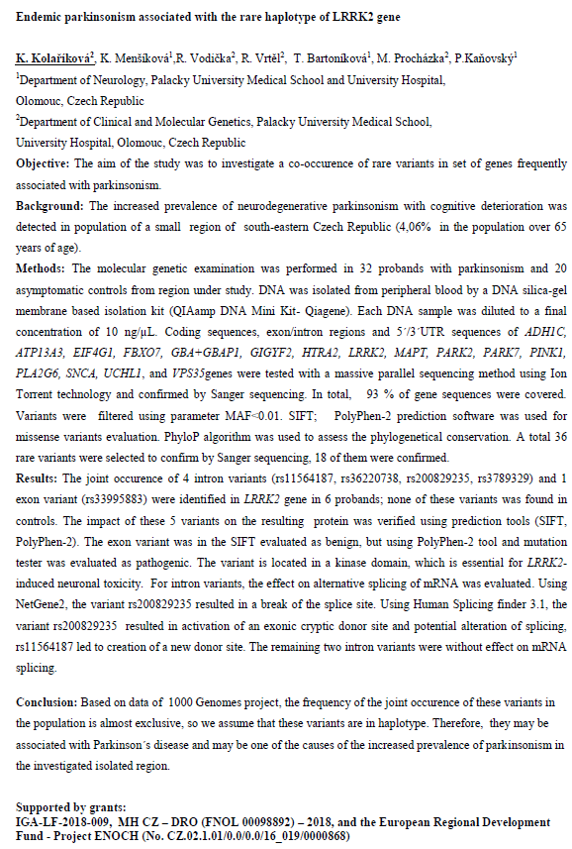

Slide 17
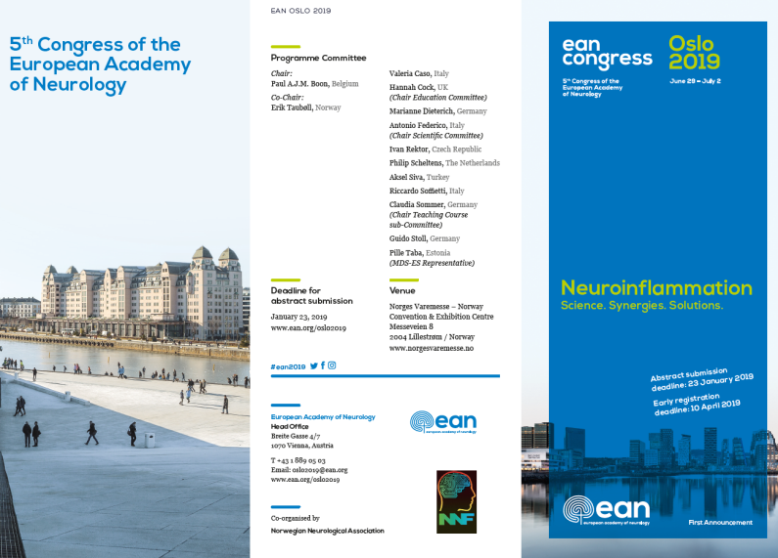
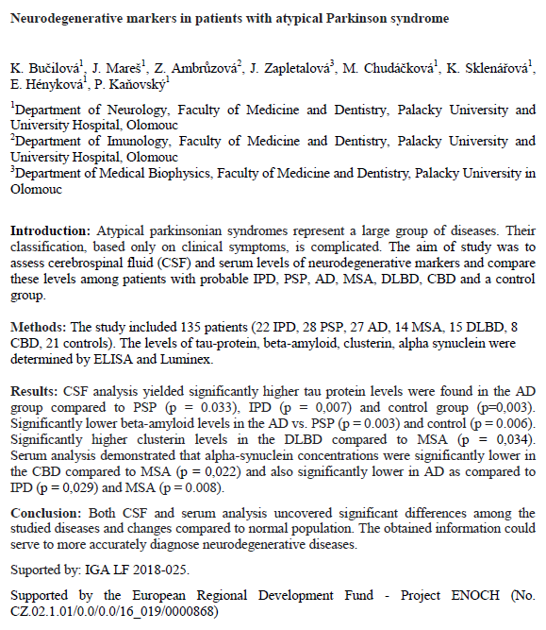
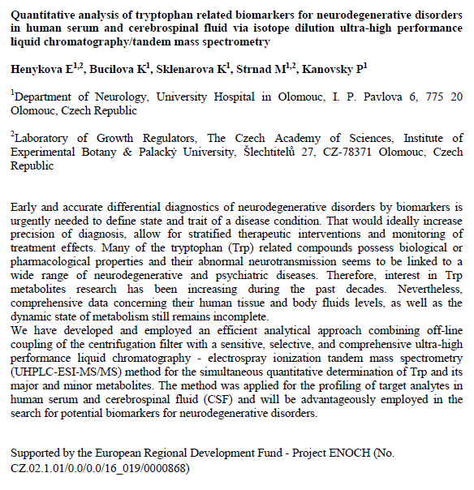

Slide 18
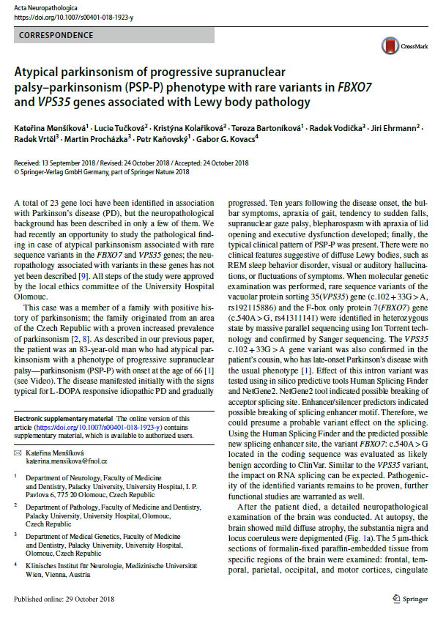
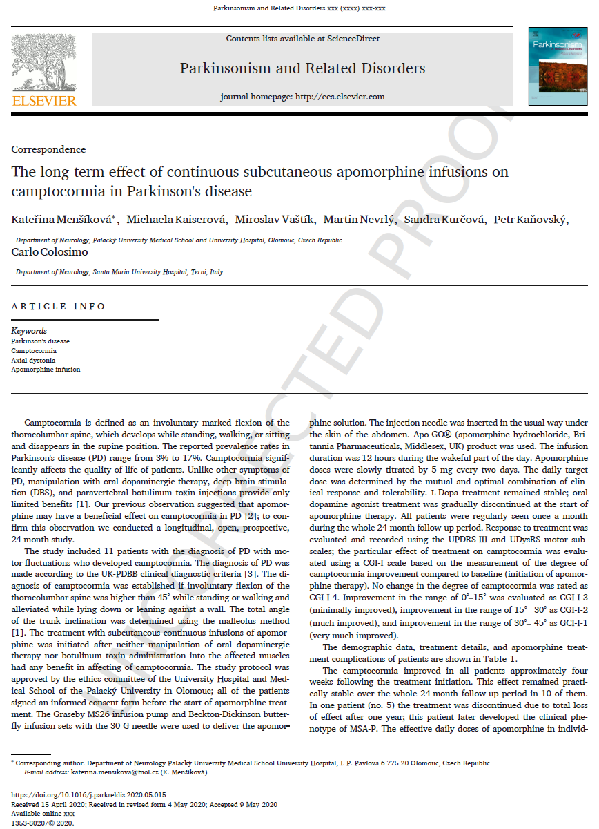
D1, Q1
D1, Q1

Slide 19
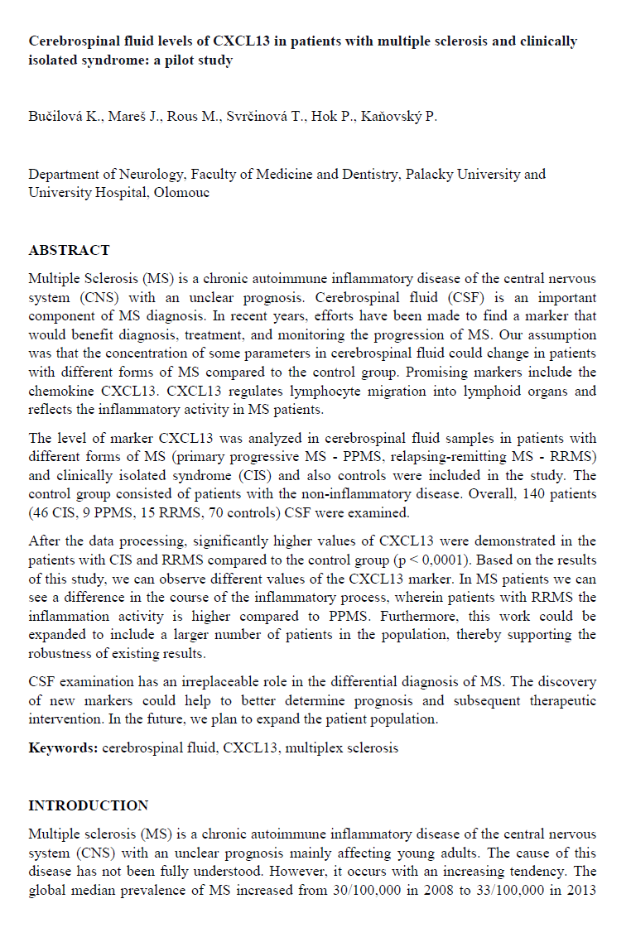
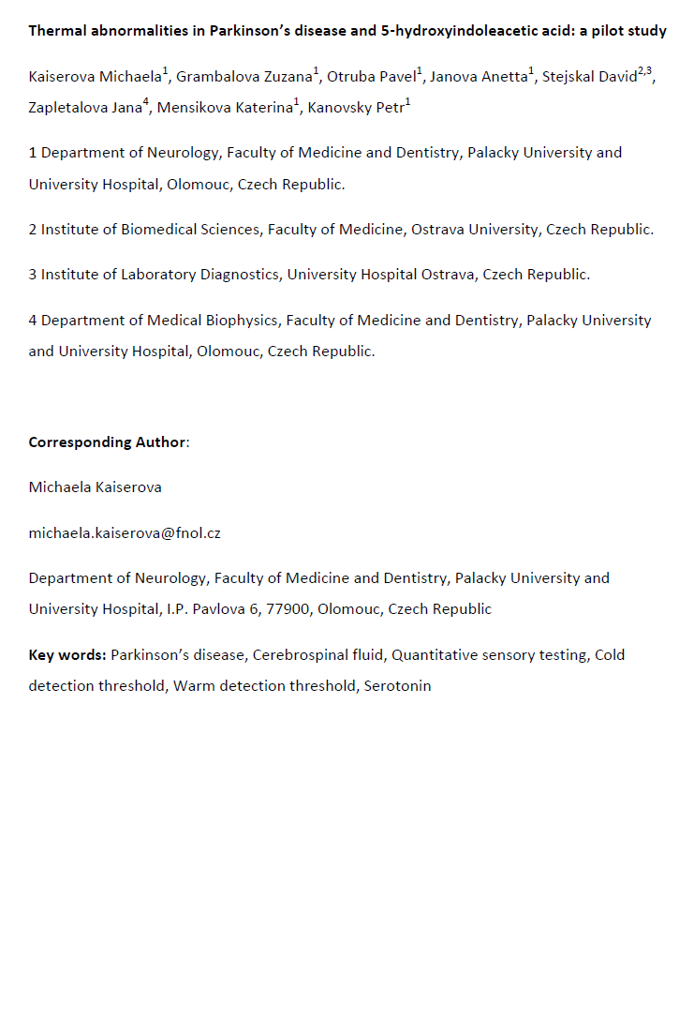
Submitted to Multiple Sclerosis (Q1)
Submitted to Acta Neurologica Scandinavica (Q1)

Slide 20
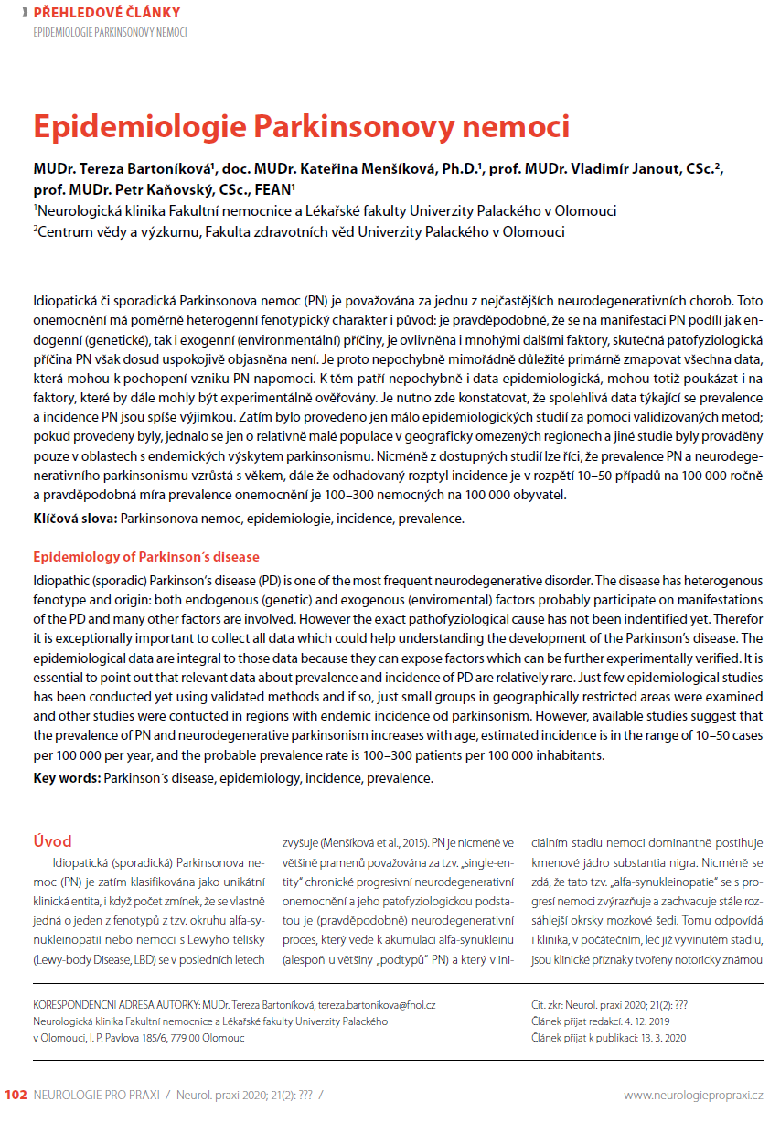
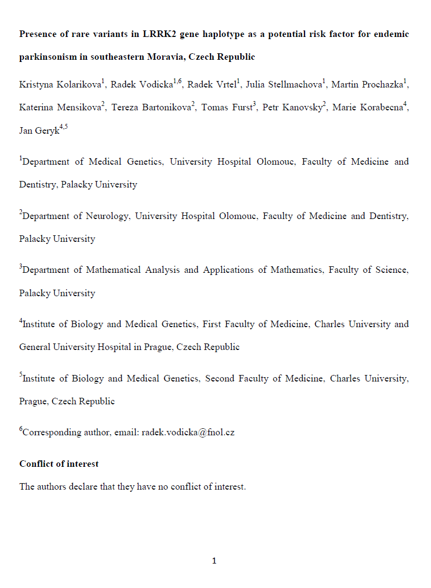
Submitted to Scientific Reports (Q1)

Slide 21
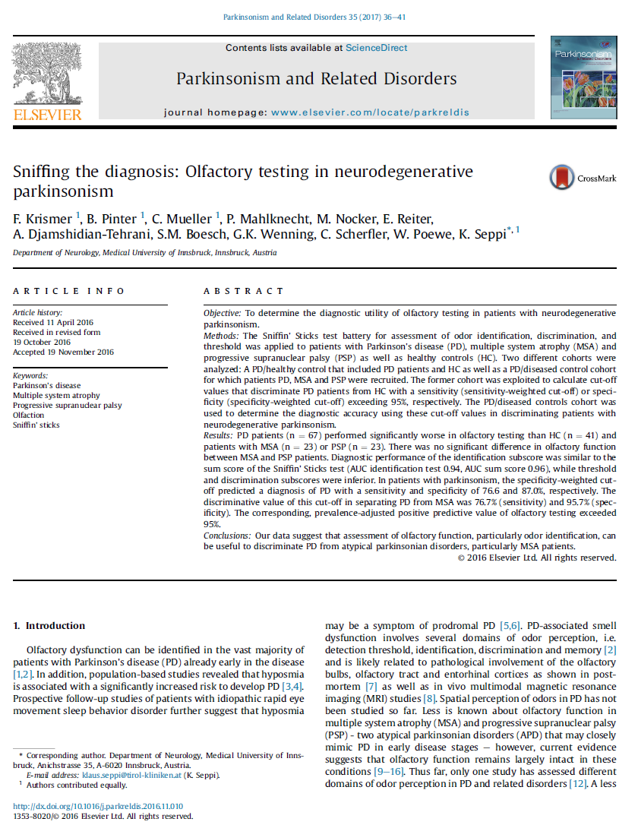
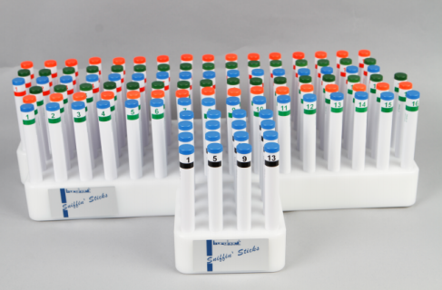

Slide 22
PGP 9.5
phospho α-synuclein
merge
Courtesy of Department of Clinical and Molecular Pathology, Palacky University Medical School and University Hospital, Olomouc, Czech Republic

Slide 23
Jméno | rok nar. | Klinická dg. | Patologická dg. | Tau protein | B-amyl.42 | index tau/beta | cyst.C
X.Y. , F. | 1947 | MSA | MSA-P | 717 | 781,38 | 0,92 | 3,84
X.Y., F. | 1944 | MSAc4 | PSP+AD | 237 | 408,75 | 0,58 | 4,01
X.Y., F. | 1967 | FTLD-MND | FTLD-MND | 535 | 662,38 | 0,81 | 2,62
X.Y., F. | 1951 | PSP | PSP | 88 | 787,86 | 0,23 | 4,3
X.Y., M. | 1941 | MSA | PSP | 156 | 687,27 | 0,11 | 4,72
X.Y., M. | 1940 | IPD | MSA-P | 376 | 808,57 | 0,47 | 4,73
X.Y., M. | 1939 | AD | FTL-bv | 568 | 485,27 | 1,17 | 4,818
X.Y., M. | 1949 | AD | AD | 253 | 231,81 | 1,09 | 2,53
X.Y., M. | 1942 | MSA | MSA | 303 | 219,01 | 1,38 | 2,742
X.Y., F. | 1946 | PSP | PSP | 113 | 413,2 | 0,27 | 2,166
X.Y., F. | 1948 | MSA | PSP | 334 | 726,91 | 0,46 | 2,567
X.Y., M. | 1933 | PSP-P | PD, Alzheimerovská patologie A1B1C0 | 168 | 851 | 0,2 | 3,47

Slide 24
